Slide 1
Health Care Mini Project

Slide 2
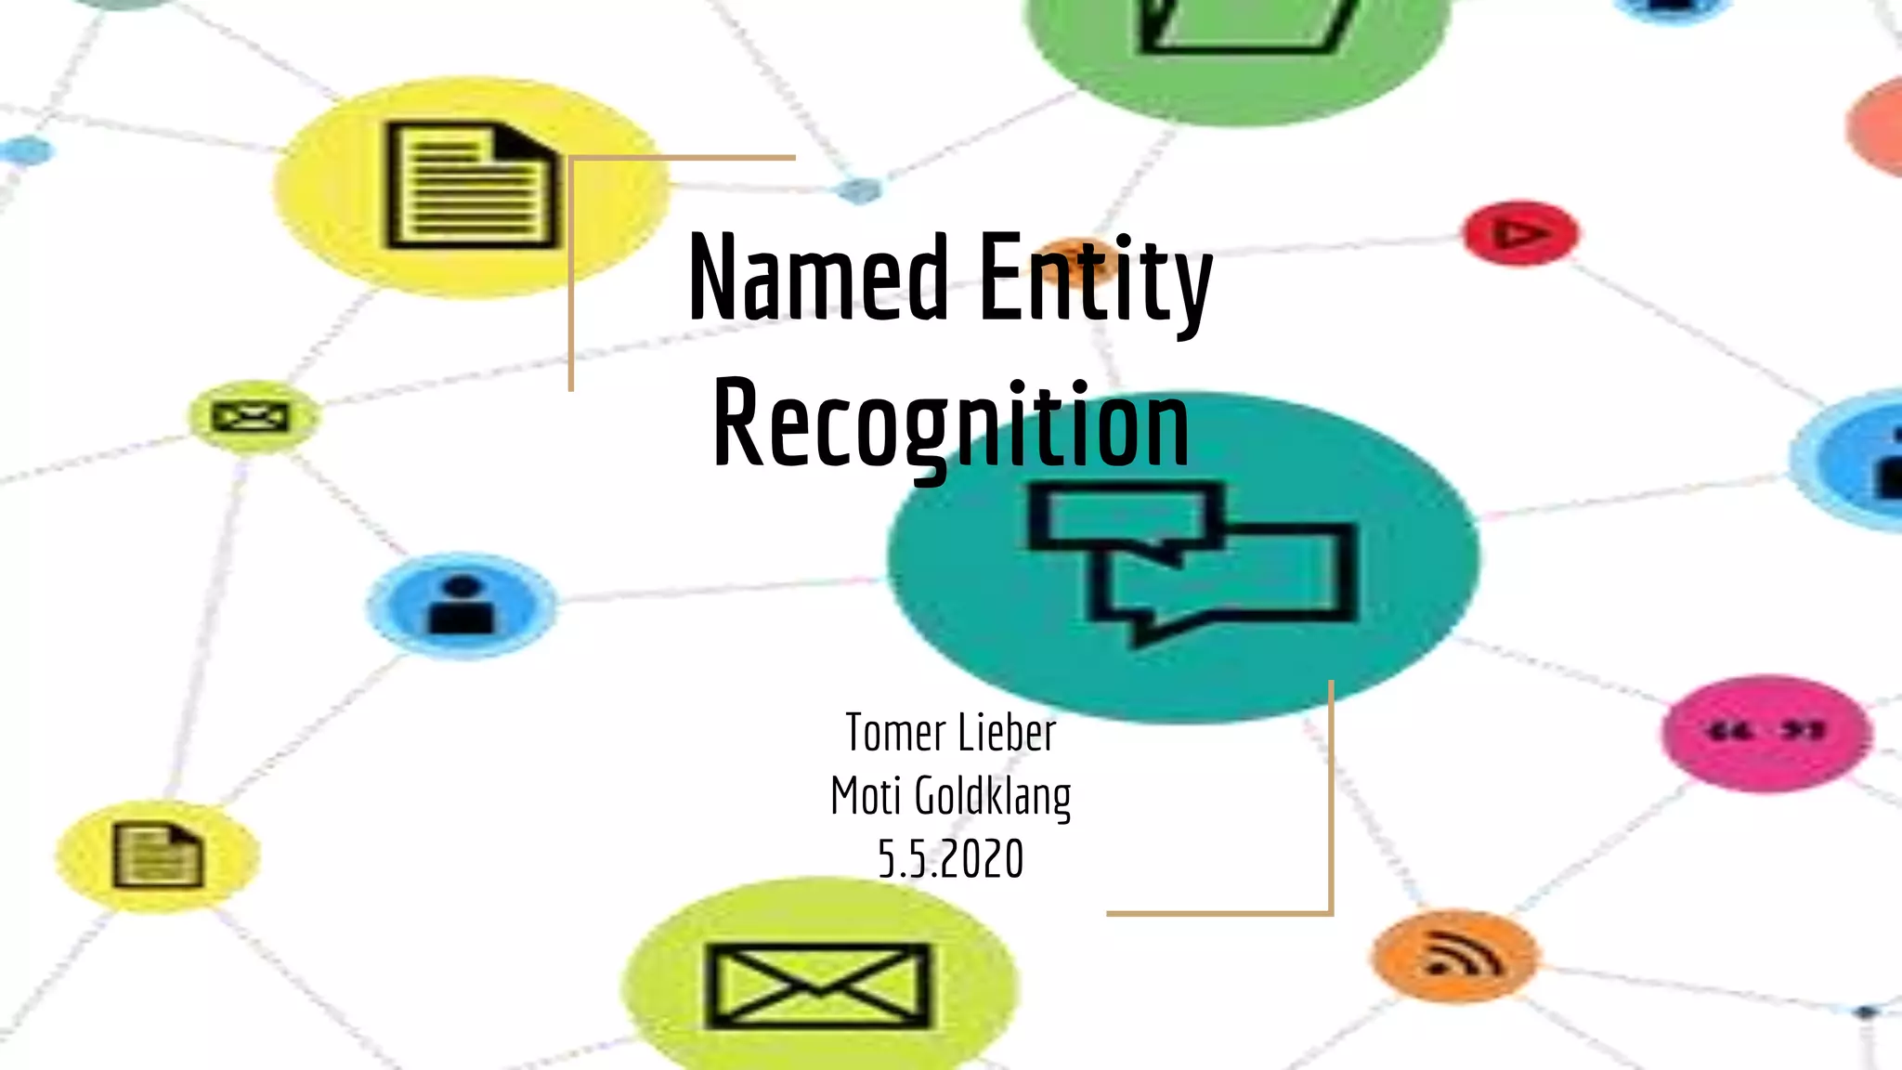
Biomedical-Named-Entity-Recognition

Slide 3
In any text content, there are some terms that are more informative and unique in context.
Named Entity Recognition (NER) also known as information extraction/chunking.
Algorithm extracts the real world noun entity from the text data and classifies them into predefined categories like person, place, time, organization, etc.
What is NER ?

Slide 4
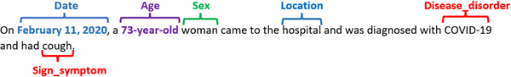
NER in bio-medical
To develop the NER system to recognise and classify the Biomedical substances from the text.
This BIO-NER system can be used in various areas like a question-answering system or summarization system and many more areas of the domain-dependent NLP research.

Slide 5
Objective
Exploring different pre-trained models available in Scispacy,Bio-Bert transformer models
Design a pre-trained BIO-NER transformer model web app
Use cases/case study

Slide 6
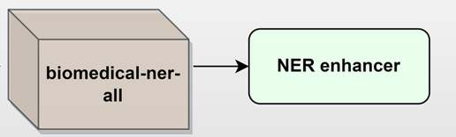
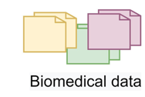
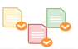
Development Architecture - Pre-trained Model

Slide 7
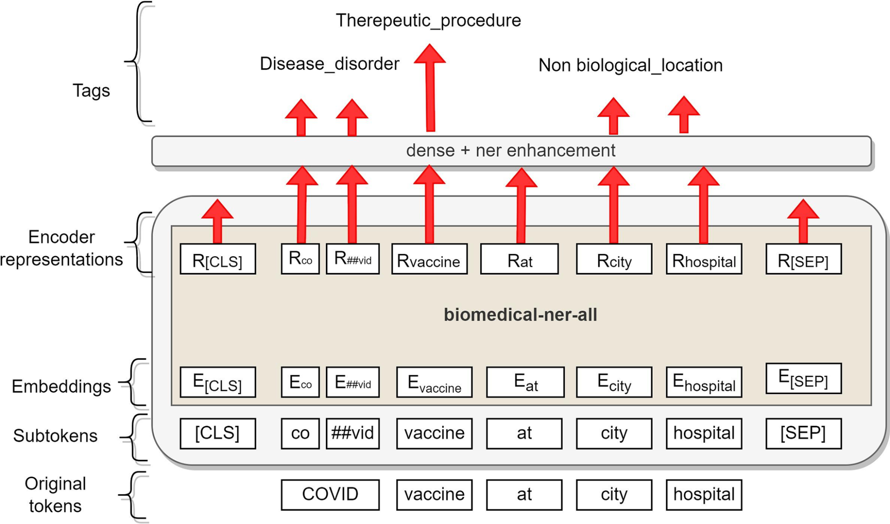
biomedical-ner-all model layers
Notes:
As the input for the BERT model, we use the CoNLL-2003 [32] formatted data, split into sentences and tokenized on the word level. Sentences more prolonged than the limit (512 sequences) are split into separate input sequences for the network. When converting the predictions back to the word-level CoNLL format, we assign the predicted entity label of the first sub-word unit for the entire token.

Slide 8
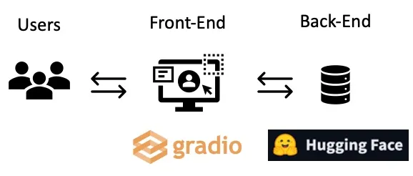
Bio-Medical-NER Framework
Gradio and Hugging Face provide the framework for fast building of deep learning apps.

Slide 9
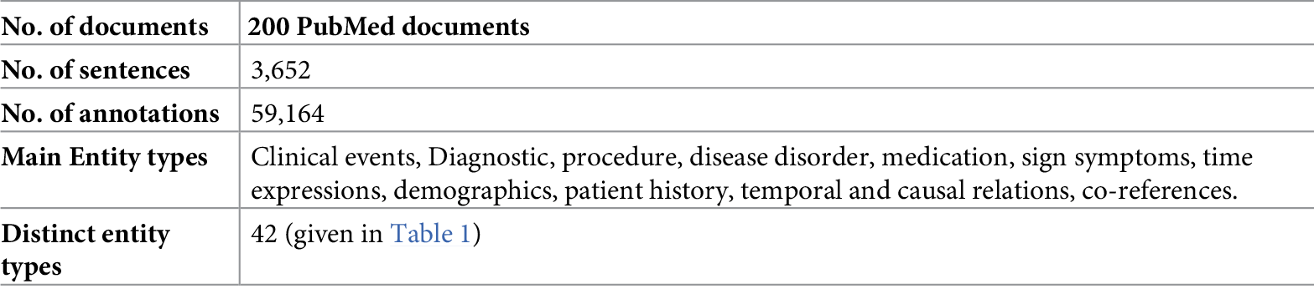
Dataset Used in the model
Reference journal: https://journals.plos.org/digitalhealth/article?id=10.1371/journal.pdig.0000152#pdig-0000152-g002

Slide 10
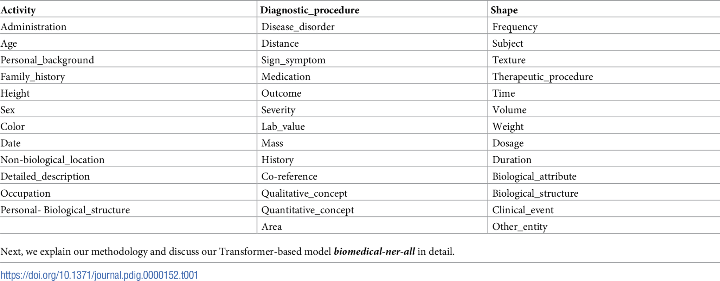
Entity Types

Slide 11
Pre-Trained Model - Evaluation Results
Pre_Trained_Model_Used | Number of Predicted Entities
en_ner_bc5cdr_md(scispacy) | 12/59
en_core_sci_lg- Model(scispacy) | 54/59 (Generalised Label ENTITY)
en_ner_bionlp13cg_md(scispacy) | 20/59
en_core_med7_trf(spacy) | 0 (Input doesn't match the pretrained model )
biomedical-ner-all(transformer) | 50/59 (mostly matches the input data)
biobert-large-cased-v1.1 | 56/59 (Generalised Entity LABEL_1,LABEL_0)
bert-base-uncased_clinical-ner(transformer) | 49/59
Medspacy | To verity entities require UMLs knowledge base. UMLS contains the dictionary of medical terms
Ref:bio-ner-test-cases

Slide 12
Why biomedical-ner-all pre-trained model ?
In the state-of-the-art biomedicine works, there are usually a few named entities, such as diseases, genes, proteins, chemicals or species.
However, this model provide clinical, non-clinical (demographics), and epidemiological named entities related to infectious diseases and the events

Slide 13
Comparison of present/previous method
Doctor Robo Notifier (previous method) | Biomedical-ner-all (current method transformer)
Rule based extraction for lab entities | Deep Learning transformer model trained with manual annotated data
Negation handled | Negation not handled
Api such as SNOMEDCT_US, ICD10CM,UML etc | Pre-trained transformer model used
Uses api , which is common for any type of reports | Trained on pubmed dataset related to Epidemiology
No need of annotation | Requires annotation and domain knowledge for annotation

Slide 14
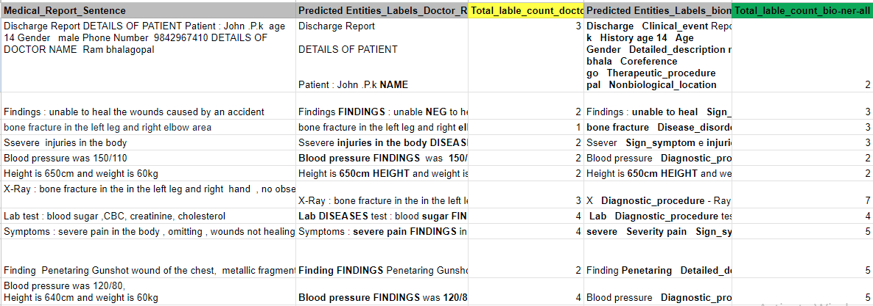
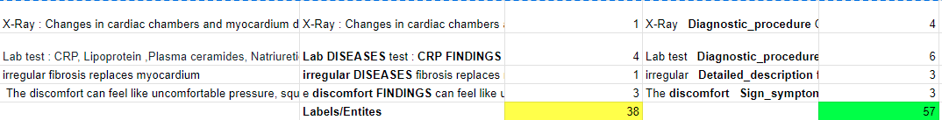
Result Comparison

Slide 15
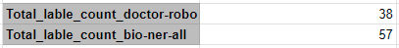
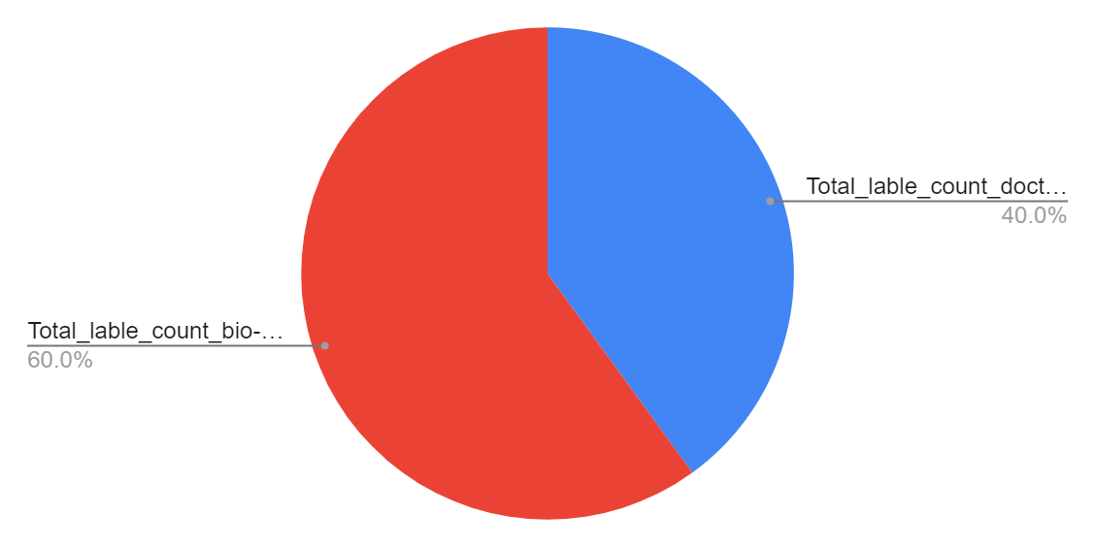
Pie-Chart Representation Of Entities Count

Slide 16
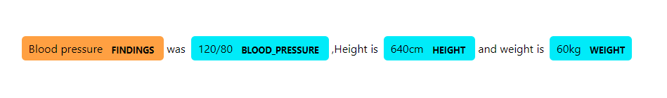
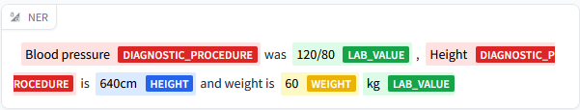
Sample Result
Input Text: Blood pressure was 120/80, Height is 640cm and weight is 60kg
Doctor Robo Output: Entities Count (4)
Biomedical-ner-all Output: Entities Count (6)

Slide 17
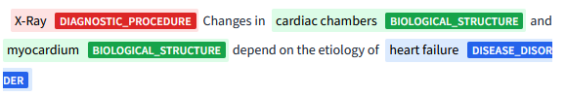
Sample Result
Input Text: X-Ray : Changes in cardiac chambers and myocardium depend on the etiology of heart failure.
Doctor Robo Output: Entities Count (1)
Biomedical-ner-all Output: Entities Count (6)

Slide 18
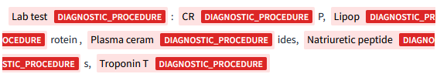
Sample Result
Input Text: Lab test : CRP, Lipoprotein ,Plasma ceramides, Natriuretic peptides, Troponin T
Doctor Robo Output: Entities Count (4)
Biomedical-ner-all Output: Entities Count (6)

Slide 19
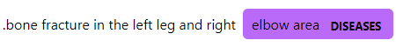
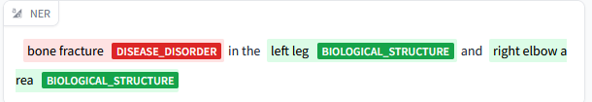
Sample Result
Input Text: bone fracture in the left leg and right elbow area
Doctor Robo Output: Entities Count (1)
Biomedical-ner-all Output: Entities Count (3)

Slide 20
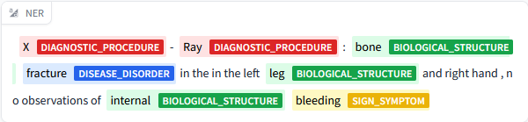
Sample Result
Input Text: X-Ray : bone fracture in the in the left leg and right hand , no observations of internal bleeding
Doctor Robo Output: Entities Count (4)
Biomedical-ner-all Output: Entities Count (7)

Slide 21
Drawback / Challenges
To fine-tune the model , will require manual annotation , data. There isnt no proper reference on manual annotation, tools used
To annotate the exact term related to biomedical terms need a domain knowledge
The pretrained model uses dataset from official medical corpus, no proper reference on fine-tuning methods

Slide 22
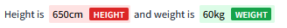
CASE STUDY: BIO-MEDICAL-NER
Sample Input:Discharge Report :Height is 650cm and weight is 60kg
user input
Gradio
(Front End)
Biomedical-ner-all
(Word-level-token)
height
NER enhancer
(tags/label)
Bio-medical Entities
Tested a discharge report by taking each line as sentence

Slide 23
Use Case output

Slide 24
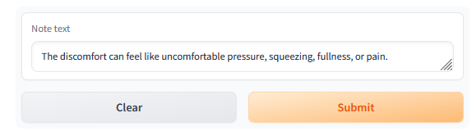
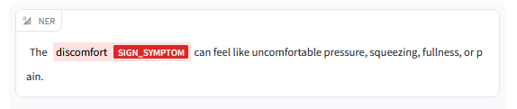
Test Case 1:
For UI have used gradio which has inbuilt functionality for ner,dashboard etc..
Model: biomedical-ner-all
Input:
Output

Slide 25
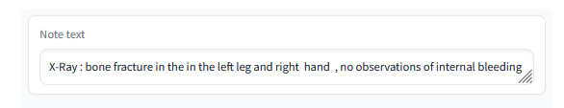
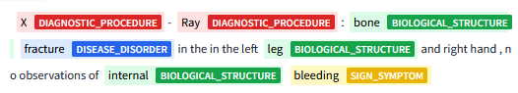
Output Examples
Example: biomedical-ner-all
Input:
Output

Slide 26
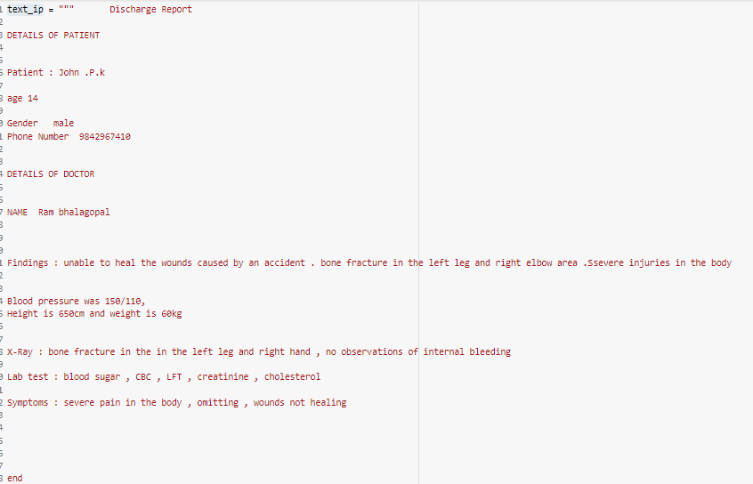
Data-Cleaning
After removing space (Input data)
Before removing space (Input data)
Discharge Report DETAILS OF PATIENT Patient : John .P.k age 14 Gender male Phone Number 9842967410 DETAILS OF DOCTOR NAME Ram bhalagopal Findings : unable to heal the wounds caused by an accident . bone fracture in the left leg and right elbow area .Ssevere injuries in the body Blood pressure was 150/110, Height is 650cm and weight is 60kg X-Ray : bone fracture in the in the left leg and right hand , no observations of internal bleeding Lab test : blood sugar , CBC , LFT , creatinine , cholesterol Symptoms : severe pain in the body , omitting , wounds not healing end

Slide 27
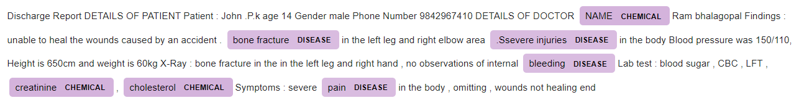
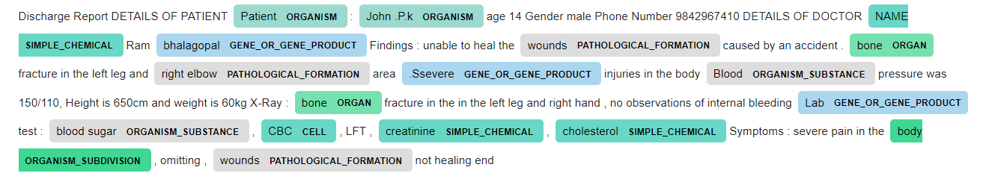
En_ner_bc5cdr_md- Model Output
A spaCy NER model trained on the BC5CDR corpus to detect disease,chemical
Wrongly detected as chemical
En_ner_bionlp13cg_md- Model Output
A spaCy NER model to detect biomedical terms such as organism,gene

Slide 28
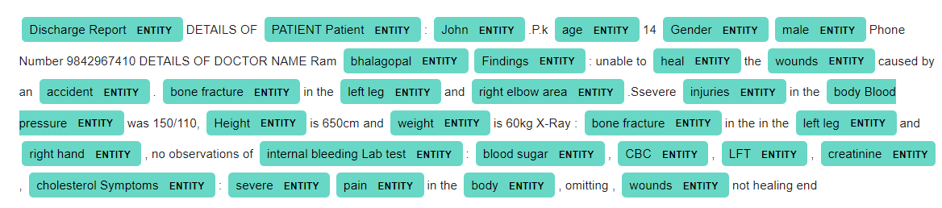
En_core_sci_lg- Model Output
Detect biomedical terms and vocabulary as entities
In en_ner_bc5cdr_md pre-trained model its observed that some of the words are wrongly detected as disease, chemical. With En_core_sci_lg model most of the words are detected as entity.en_ner_bionlp13cg_md mostly used to detect cancer cells, antomy etc. type of words

Slide 29
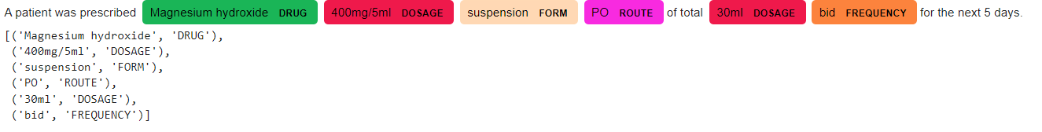
En_core_med7_lg- Model Output
Med7 detects Dosage, Strength,Duration and Route as entities

Slide 30
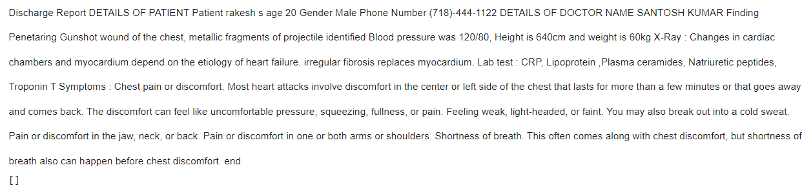
En_core_med7_lg- Model Output
Med7 detects Dosage, Strength,Duration and Route as entities
There are no relative terms associate with the med 7 library, so the terms are not detected.
Medspacy
Medspacy Quickuml requires license to get the uml concepts to be verified from knowledge base

Slide 31
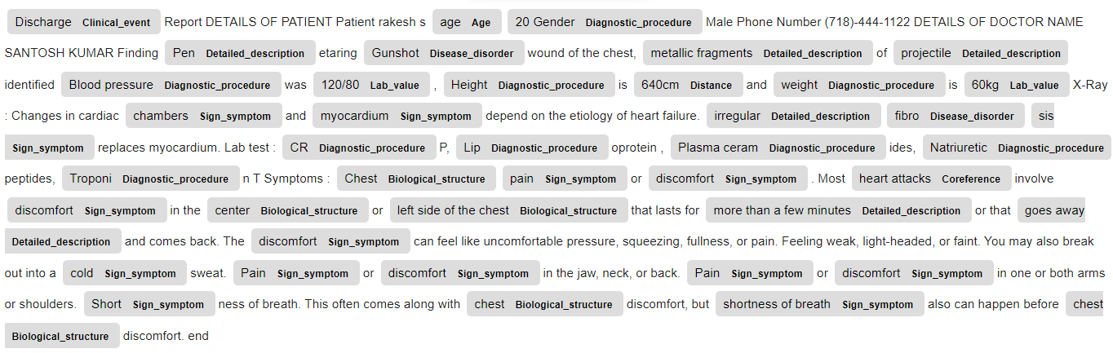
biomedical-ner-all
An English Named Entity Recognition model, trained on Maccrobat to recognize the bio-medical entities (83 entities) from a given text corpus (case reports etc.). This model was built on top of distilbert-base-uncased

Slide 32
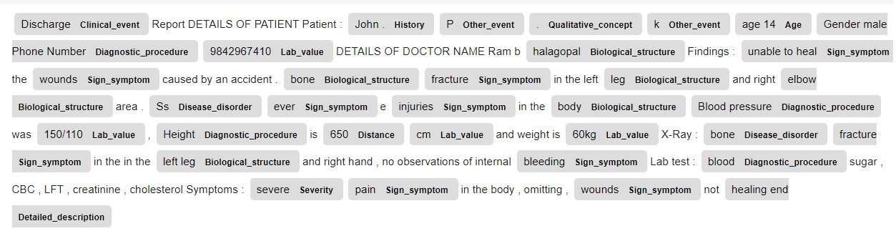
biomedical-ner-all
An English Named Entity Recognition model, trained on Maccrobat to recognize the bio-medical entities (84 entities) from a given text corpus (case reports etc.). This model was built on top of distilbert-base-uncased

Slide 33
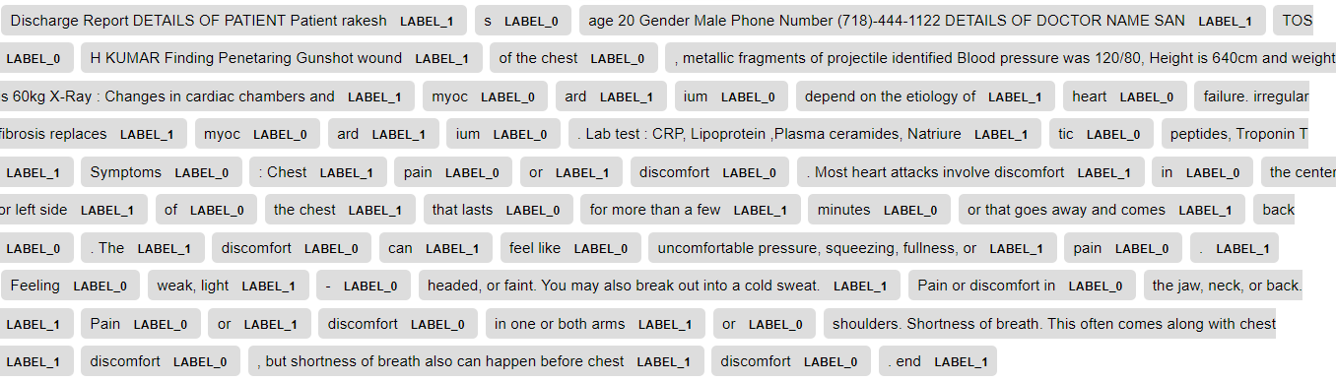
biobert-large-cased-v1.1
BioBERT, a biomedical language representation model designed for biomedical text mining tasks such as biomedical named entity recognition, relation extraction, question answering
In this all the entities are highlighted as LABEL_1, LABEL_0. To change the label need to custom map the entities

Slide 34
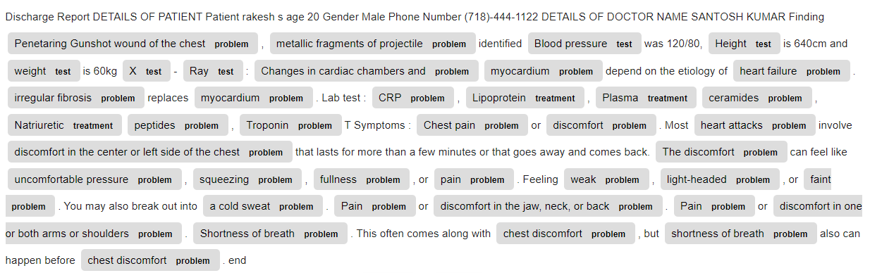
bert-base-uncased_clinical-ner
A Named Entity Recognition model for clinical entities (problem, treatment, test).The model has been trained on the i2b2 (now n2c2) dataset for the 2010 - Relations task.
This model has 6 labels which are problem,test,treatment,problem

Slide 35
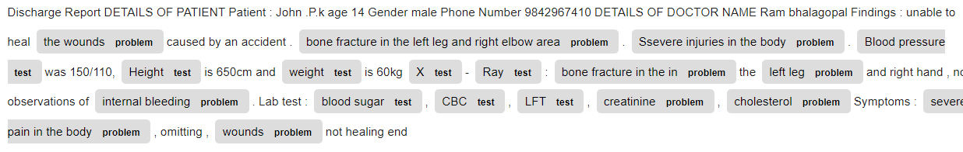
bert-base-uncased_clinical-ner
A Named Entity Recognition model for clinical entities (problem, treatment, test).The model has been trained on the i2b2 (now n2c2) dataset for the 2010 - Relations task.
This model has 3 labels which are problem,test,treatment

Slide 36
Result analysis
Based on the analysis two transformer model perform equally well biomedical-ner-all, bert-base-uncased_clinical-ner
With biomedical-ner-all model the datasets are collected from pubmed and manually annotated
In the bert-base-uncased_clinical-ner there is no option to annotate instead they collect the data from biomed corpus which requires access for some sites
Drawback of the biomedical-ner-all model is that there is no proper reference on manual annotation

Slide 37
CUSTOM TRAINING (BERT TRANSFORMER MODEL)

Slide 38
Objective: (BIO-MEDICAL DOMAIN)
What is Fine-Tuning ?
To Fine tune the data with ner annotated disease data set using bio-bert as base model.
For fine-tuning, the BERT model is first initialized with the pre-trained parameters, and all of the parameters are fine-tuned using labeled data from the downstream tasks.

Slide 39
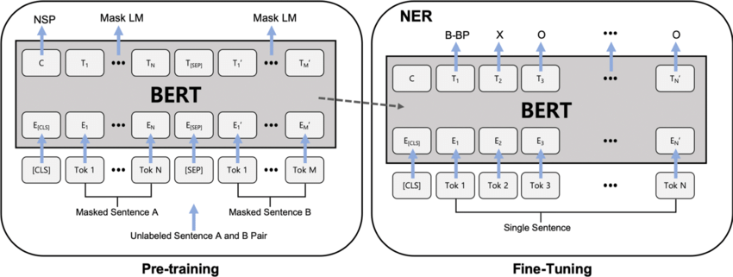
BERT architecture and fine-tuning
Notes:
As the input for the BERT model, we use the CoNLL-2003 [32] formatted data, split into sentences and tokenized on the word level. Sentences more prolonged than the limit (512 sequences) are split into separate input sequences for the network. When converting the predictions back to the word-level CoNLL format, we assign the predicted entity label of the first sub-word unit for the entire token.

Slide 40
Development Flow Diagram - Fine-Tuned Model
NE BIO annotated data
Fine Tuning of Bio-bert
New Pretrained Model

Slide 41
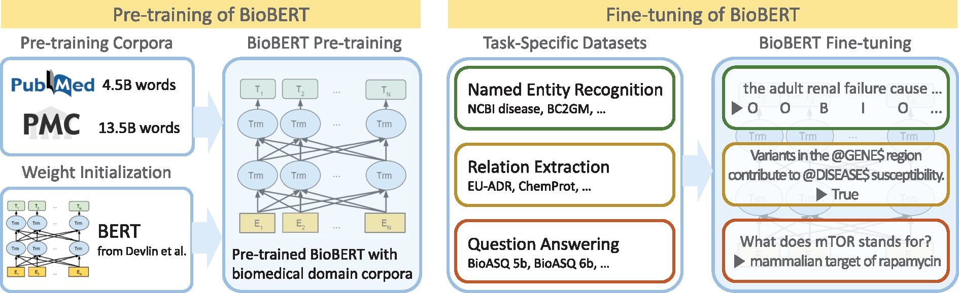
Overview of the pre-training and fine-tuning of BioBERT

Slide 42
Bio-Medical-NER Framework
Gradio and Hugging Face provide the framework for fast building of deep learning apps.

Slide 43
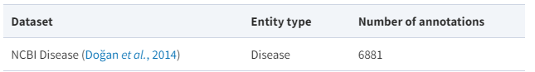
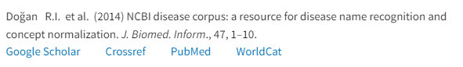
Biomedical named entity recognition datasets
The pre-processed NCBI Disease dataset has fewer annotations than the original dataset due to the removal of duplicate articles from its training set.
Reference journals:
https://doi.org/10.1093/bioinformatics/btz682

Slide 44
Code Modules DISEASE NER

Slide 45
Code Review
Code Module
Data Collect NER Dataset (BIO format)
Training Module
Prediction Module
UI interface + pipeline
Achievements/completed tasks
Custom Training
Prediction
UI interface

Slide 46
Steps to Fine-Tune the model
Setup. Install pip packages. Import libraries. Resources.
Python 3.10 ,transformers==4.8.1, torch1.8.1 , seqeval-1.2.2
Load and preprocess the dataset. Get the dataset from dmis-lab Datasets. Preprocess the data.
Build, train and export the model. Build the model. Restore the encoder weights. ...

Slide 47
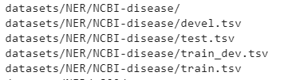
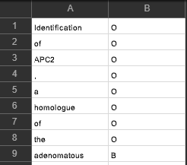
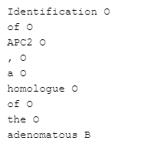
Step 1: Download the dataset using bash
Generated dataset
Step 2: Convert the .tsv to .txt file for training using !bash preprocess.sh
BIO format for bio-bert mode train
train-dev.tsv
train-dev.txt

Slide 48
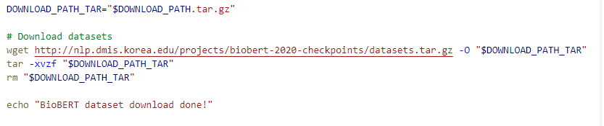
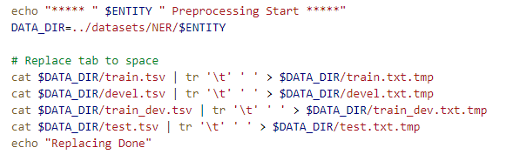
Download the dataset, tsv to temp.txt format
download.sh script to download the ncbi disease dataset
With pre-process.sh script tsv converted to train.txt.tmp file

Slide 49
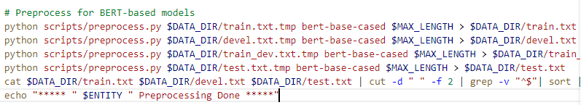
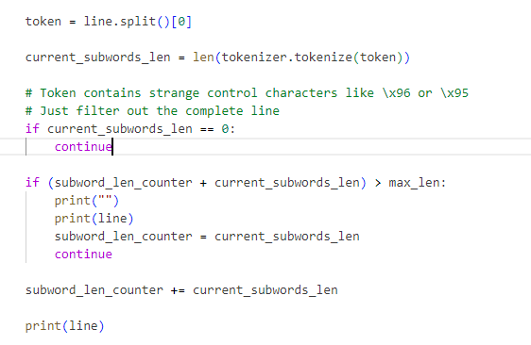
tmp.txt to txt conversion code
With pre-process.py converts temp.txt to .txt
Function filters the line with control characters

Slide 50
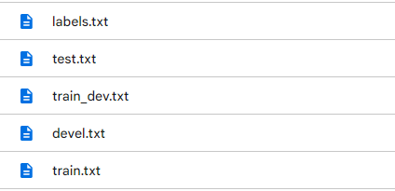
Dataset File Structure After Conversion
Train : Evaluation : Test ---> 80:10:10

Slide 51
Training , Prediction Code Module

Slide 52
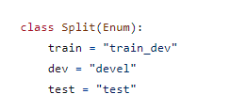
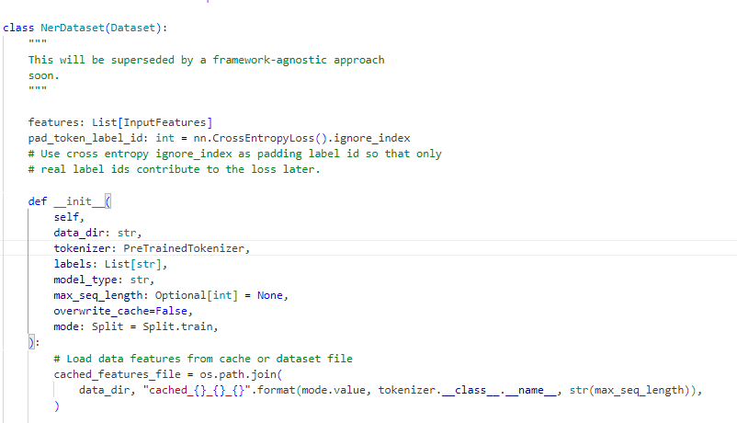

Step 3: Imported functions from utils.py NerDataset, Split, get_labels classes to run_ner.py function
Split class reads the train_dev, devel, test dataset
NerDataset class takes the dataset, pre-trained tokeniser as input , sequence length and other parameters as input for training
Notes:
It measures the difference between the predicted class probabilities and the true class labels.where output is a tensor of predicted class probabilities of shape (batch_size, num_classes) and labels is a tensor of true class labels of shape (batch_size).

Slide 53


Step 4: DataTrainingArguments class defines the type of data to be passed for training in run_ner.py function
Converts the data to command line parser object

Slide 54

Step 5: Below code block explains about the label dict conversion, pre-trained config,tokeniser to be used for training
Converter labels to dictionary {0:bio-disease}
Variable holds the pretrained model cofig, tokeniser and models

Slide 55


Step 6: Get the training data from NerDataset class in utils.py, metrics prediction function
NerDataset class gets the dataset dir, pre-trained tokeniser as input , sequence length and other parameters as input for training, evaluation
Metrics for prediction , evaluate the prediction , labels
Compute the precision, f1score, recall

Slide 56



Step 7: run_ner.py function call for train, evaluation functions
trainer initialisation ,save the model
Evaluate the trained model with trainer.evaluate, save the model to eval_result
P,R,F1 = 1.0
Notes:
This means that our algorithm has classified an equal amount of users as false positives, as it classified false negatives.

Slide 57


Step 8: run_ner.py function call to prediction.
Testset initialisation for prediction ,save the model
Evaluate the trained model with trainer.predict, save the result to test_result.txt
F1 score : 87%
Testset initialisation for prediction ,save the model
Evaluate the trained model with unseen test.txt and save it as test_prediction.txt
Notes:
This means that our algorithm has classified an equal amount of users as false positives, as it classified false negatives.Precision = TP / (TP + FP), Sensitivity = TP / (TP + FN) , F1-Score = 2(Precision*Sensitivity)/(Precision+Sensitivity) = TP / (TP + 1/2(FN+FP))
Precision can be seen as a measure of quality, and recall as a measure of quantity.

Slide 58

Step 9: Explicit Command to train the model

Slide 59

Prediction Result
 | Test Precision (%) | Test Recall (%) | Test F1 (%)
NCBI-disease | 85.4 | 89.2 | 87.3
Screenshot from the trained data, tested with test dataset
Notes:
evaluate() will predict + compute metrics on your test set and trainer. predict() will only predict labels on your test set

Slide 60



Prediction Code with Gradio as Frontend
Given model, tokenizer as input to the transformer pipeline
Trained model as input to the transformer pipe-line
This module has inbuilt front end for NER in gradio as text box

Slide 61
Challenges Faced- future enhancements
To find ner annotated BIO format dataset related to specific medical domains aren't available.
Most of the dataset requires license or access to their authorised website
Only few dataset are available in common domain to access & download
Future enhancements
In case of data availability, will be able to train for more entities such as test, problem etc

Slide 62

Output Examples
Example: disease-ner model
Input: (radiology case):
Mediastinal calcification and dense right upper lung nodule suggest a previous granulomatous process.
Output:

Slide 63

Output Examples
Example: disease-ner model
Input: (radiology case):
There is mild scoliosis of the spine..
Output:

Slide 64

Output Examples
Example: disease-ner model
Input: (radiology case):
There are a few XXXX opacities in the lung bases bilaterally.
Output:

Slide 65

Output Examples
Example: disease-ner model
Input: (radiology case):
No pneumothorax or pleural effusion is seen
Output:

Slide 66

Output Examples
Example: disease-ner model
Input: (radiology case):
A large hiatal hernia is noted
Output:

Slide 67


Customised the Pre-Trained Model
Have changed the code in pre-trained model (biomedical-ner-all) to filter only desired labels such as Disease_disorder, Diagnostic_procedure, Disease etc..
In this case, have filtered the 'Diagnostic_procedure' label , below is the sample output

Slide 68
Fashion Domain - BRAND NER

Slide 69
Objective
Objective is to build a model with the datasets to detect brands in product titles, for instance : detecting Zara in "New Jeans Extra Slim Zara". Mostly used in fashion industries, customer support

Slide 70


Development Flow Diagram - Fine-Tuned Model
Processed Data
Fine Tune (Bert-base case model)
text
label
label
Annotated Dataset
Data Pre-processing
Predict
Model
SAVE
Updated Model

Slide 71

Dataset
We use a augmented version of product titles fetched from Amazon through this dataset which has data for over 2 million products. The IOB format (short for inside, outside, beginning) is a tagging format that is used for tagging tokens in a chunking task such as named-entity recognition
Notes:
The IOB format (short for inside, outside, beginning) is a tagging format that is used for tagging tokens in a chunking task such as named-entity recognition. These tags are similar to part-of-speech tags but give us information about the location of the word in the chunk.

Slide 72
Code Modules

Slide 73
Code Review
Code Module
Data Collect NER Dataset (BIO format)
Training Module
Prediction Module
UI interface + pipeline
Achievements/completed tasks
Custom Training
Prediction
UI interface

Slide 74
Steps to Fine-Tune the model
Setup. Install pip packages. Import libraries. Resources.
Python 3.10 ,transformers==4.3.1, torch1.8.1 , seqeval-1.2.2
Load and preprocess the dataset. Get the dataset from Amazon review dataset. Preprocess the data.
Build, train and export the model. Build the model. Restore the encoder weights. ...

Slide 75


Step 1: The dataset are in the form of IOB format, below are the counts.A training example is typically a sentence, with corresponding IOB tags.
Overview of the dataset
Step 2: Filtered with unique labels , below are the counts

Slide 76

Step 3: Data-preprocessing steps are applied to remove space,"forward fill" function to fill missing values.
Step 4: Let's group the words and corresponding tags by sentence

Slide 77



Step 5: For training dataset preparation selected the columns sentence, word_label by dropping duplicates
Step 6: Unique labels are mapped with key, value pairs

Slide 78
Dataset, Data Loader, Define Model Code

Slide 79


Step 1: Key variables used in the training and evaluation process
Step 2: This function tokenizes each word one at a time so that it is easier to preserve the correct label for each subword.

Slide 80

Step 3: The class dataset used for tokenise, special tokens,truncation/padding,obtain the attention mask ,convert tokens to input ids
Notes:
The [cls] token is used for classification task whereas the [sep] is used to indicate the end of every sentence

Slide 81

Step 3: The class dataset used for tokenise, special tokens,truncation/padding,obtain the attention mask ,convert tokens to input ids cont..
Notes:
truncating = 'pre' or 'post' (default 'pre'). If a sequence length is larger than the provided maxlen value then, these values will be truncated to the maxlen Padding adds a special padding token to ensure shorter sequences will have the same length as either the longest sequence in a batch or the maximum length accepted by the model.This class is defined to accept the tokenizer, sentences and labels as input and generate tokenized output and tags that is used by the BERT model for training. Input ids are the unique identifiers of the tokens in a sentence. Attention mask is used to batch the input sequence together and indicate whether the token should be attended by our model or not.
We are using the BERT tokenizer to tokenize the data in the sentences list for encoding.
The tokenizer uses the encode_plus method to perform tokenization and generate the necessary outputs, namely: ids, attention_mask
To read further into the tokenizer, refer to this document
tags is the encoded entity from the annonated dataset.
The CustomDataset class is used to create 2 datasets, for training and for validation.

Slide 82

Step 4: based on the class we defined above, we can create 2 datasets, one for training and one for testing. Let's use a 80/20 split

Slide 83

Step 5: define the corresponding PyTorch dataloaders:
Notes:
DataLoader is a built-in class that provides an efficient and flexible way to load data into a model for training or inference.

Slide 84


Step 6: Define the model, BertForTokenClassification, and load it with the pretrained weights of "bert-base-uncased". The only thing we need to additionally specify is the number of labels
Step 7: To check the shape (batch_size, sequence_length, num_labels) and Define the optimizer.
Notes:
Gradient Descent is an algorithm that is used to optimize the cost function or the error of the model. It is used to find the minimum value of error possible in your model.
Optimizer is used to update the weights of the neural network to improve its performance.

Slide 85
Training , Prediction Module

Slide 86


Step 1: Train function with iteration, training loss calculator for each step
Training iteration
Training accuracy calculation
Notes:
The dataloader passes data to the model based on the batch size.
Subsequent output from the model and the actual category are compared to calculate the loss.
Loss value is used to optimize the weights of the neurons in the network.
After every 100 steps the loss value is printed in the console. used to gauge the error between the prediction output and the provided target value.
As you can see just in 1 epoch by the final step the model was working with a miniscule loss of 0.08503091335296631 i.e. the output is extremely close to the actual output.

Slide 87



Step 2: Data trained for 100 steps
Step 3: In Validation Function , there will be change in the loss, accuracy variable, mapping of variable
Accuracy of the test data is > 93

Slide 88



Step 4: The precision, recall and f1-score of the individual tags
Step 5 Code to save the model and saved files structure

Slide 89


Prediction Code with Gradio as Frontend
Given model, tokenizer as input to the transformer pipeline
Trained model as input to the transformer pipe-line
This module has inbuilt front end for NER in gradio as text box

Slide 90
Challenges Faced
To find ner annotated BIO format dataset related to fashion domain and example training code
Faced issue in the tokenization , training code for the latest version of transformers, tokeniser
Future enhancements
In case of data availability, will be able to train for more entities such as 'COLOR',’'SIZE/WEIGHT','MATERIAL','GENDER','PRODUCT' based on the requirement

Slide 91

Output Examples
Example: BRAND-NER MODEL
Input: (Unseen Data):
Silk Screen Refining Powder Makeup, 24 Meikkivoide Meikki Origins
Output:

Slide 92

Output Examples
Example: BRAND-NER MODEL
Input: (Unseen Data):
ITP Bajacross ( 26x10.00 R14 TL 81D )
Output:

Slide 93

Output Examples
Example: BRAND-NER MODEL
Input: (Unseen Data):
Calvin Klein Earth Miesten kello K5Y31XWL Vihre\u00e4/Nahka \u00d844 mm
Output:

Slide 94

Output Examples
Example: BRAND-NER MODEL
Input: (Unseen Data):
"Just Cavalli Silm\u00e4lasit JC 0817 086"
Output:

Slide 95

Output Examples
Example: BRAND-NER MODEL
Input: (Unseen Data):
Alliance Forestry 333 ( 320/85 -24 127A8 14PR TL kaksoistunnus\u00a0 124B )
Output:

Slide 96
Tourism Domain- Location,Review,Food

Slide 97


Step 1: The dataset are in the form of IOB format, below are the counts.A training example is typically a sentence, with corresponding IOB tags.
Overview of the dataset
Step 2: Filtered with unique labels , below are the counts

Slide 98

Step 3: Data-preprocessing steps are applied to remove space,"forward fill" function to fill missing values.
Step 4: Let's group the words and corresponding tags by sentence

Slide 99


Step 5: For training dataset preparation selected the columns sentence, word_label by dropping duplicates
Step 6: Unique labels are mapped with key, value pairs

Slide 100
Dataset, Data Loader, Define Model Code

Slide 101
Step 1: Key variables used in the training and evaluation process
Step 2: This function tokenizes each word one at a time so that it is easier to preserve the correct label for each subword.

Slide 102
Step 3: The class dataset used for tokenise, special tokens,truncation/padding,obtain the attention mask ,convert tokens to input ids
Notes:
The [cls] token is used for classification task whereas the [sep] is used to indicate the end of every sentence

Slide 103
Step 3: The class dataset used for tokenise, special tokens,truncation/padding,obtain the attention mask ,convert tokens to input ids cont..
Notes:
truncating = 'pre' or 'post' (default 'pre'). If a sequence length is larger than the provided maxlen value then, these values will be truncated to the maxlen Padding adds a special padding token to ensure shorter sequences will have the same length as either the longest sequence in a batch or the maximum length accepted by the model.This class is defined to accept the tokenizer, sentences and labels as input and generate tokenized output and tags that is used by the BERT model for training.
For the BertTokenizer , 1 indicates a value that should be attended to, while 0 indicates a padded value.This input is specific to encoder-decoder models, and contains the input IDs that will be fed to the decoder
We are using the BERT tokenizer to tokenize the data in the sentences list for encoding.
The tokenizer uses the encode_plus method to perform tokenization and generate the necessary outputs, namely: ids, attention_mask
To read further into the tokenizer, refer to this document
tags is the encoded entity from the annonated dataset.
The CustomDataset class is used to create 2 datasets, for training and for validation.

Slide 104
Step 4: based on the class we defined above, we can create 2 datasets, one for training and one for testing. Let's use a 80/20 split

Slide 105
Step 5: define the corresponding PyTorch dataloaders:

Slide 106
Step 6: Define the model, BertForTokenClassification, and load it with the pretrained weights of "bert-base-uncased". The only thing we need to additionally specify is the number of labels
Step 7: To check the shape (batch_size, sequence_length, num_labels) and Define the optimizer.
Notes:
Optimizer is defined in the next cell.
We do not define any Loss function since the specified model already outputs Loss for a given input.
Optimizer is used to update the weights of the neural network to improve its performance.

Slide 107
Training , Prediction Module

Slide 108
Step 1: Train function with iteration, training loss calculator for each step
Training iteration
Training accuracy calculation
Notes:
The dataloader passes data to the model based on the batch size.
Subsequent output from the model and the actual category are compared to calculate the loss.
Loss value is used to optimize the weights of the neurons in the network.
After every 500 steps the loss value is printed in the console.
As you can see just in 1 epoch by the final step the model was working with a miniscule loss of 0.08503091335296631 i.e. the output is extremely close to the actual output.

Slide 109


Step 2: Data trained for 100 steps
Step 3: In Validation Function , there will be change in the loss, accuracy variable, mapping of variable
Accuracy of the test data is > 97

Slide 110

Step 4: The precision, recall and f1-score of the individual tags
Step 5 Code to save the model and saved files structure

Slide 111
Prediction Code with Gradio as Frontend
Tourist ner
Given model, tokenizer as input to the transformer pipeline
Trained model as input to the transformer pipe-line
This module has inbuilt front end for NER in gradio as text box

Slide 112
Challenges Faced
To find ner annotated BIO format dataset related to tourism domain , was challenging to find the dataset related to bert format in csv format
Faced issue in the tokenization , training code for the latest version of transformers, tokeniser
Future enhancements
In case of data availability, can explore tourism data related to hotels,shops

Slide 113

Output Examples
Example: Tourism-NER MODEL
Input: (Unseen Data):
Great location, beautiful surrounding atmosphere, great staff.
Output:

Slide 114

Output Examples
Example: Tourism-NER MODEL
Input: (Unseen Data):
Everything about the hotel was exceptional. It was clean, stylish, roomy with excellent service in where we had dinner.
Output:

Slide 115

Output Examples
Example: Tourism-NER MODEL
Input: (Unseen Data):
It needs to either have a buffet service or faster serving time. It also needs to reduce mistakes in taking orders.
Output:

Slide 116

Output Examples
Example: Tourism-NER MODEL
Input: (Unseen Data):
This place is great! Atmosphere is chill and cool but the staff is also really friendly.
Output:

Slide 117

Output Examples
Example: Tourism-NER MODEL
Input: (Unseen Data):
This is the original and authentic Indian restaurant I would like to say original flavour of Indian food service is five star
Output:

Slide 118
HR Domain- Resume NER

Slide 119
Objective
The objective was to build a NER model to parse through a given resume and extract "hard skills" and "soft skills" information. We build custom training to fit the NER model and then test it on resumes sourced from the internet.

Slide 120

Development Flow Diagram - Fine-Tuned Model
Processed Data
GRADIENT
text
label
label
Resume Annotated Data
Data Pre-processing
Predict
Model
SAVE
Updated Model
Notes:
Gradient Descent is an algorithm that is used to optimize the cost function or the error of the model. It is used to find the minimum value of error possible in your model.

Slide 121

Dataset
The above dataset consisting of 220 annotated resumes can be found [here](https://dataturks.com/projects/abhishek.narayanan/Entity Recognition in Resumes). We train the model with 200 resume data and test it on 20 resume data.

Slide 122
Code Modules

Slide 123
Code Review
Code Module
Annotated json resume dataset
Training Module
Prediction Module
UI interface
Achievements/completed tasks
Custom Training
Prediction
UI interface

Slide 124
Steps to Train spacy-transformer model
Setup. Install pip packages. Import libraries. Resources.
Python 3.10 ,transformers==4.3.0, spacy-3.5.3 , seqeval-1.2.2
Load and preprocess the dataset. Get the dataset from datadrunks annotated Datasets. Preprocess the data.
Build, train and export the model. Build the model. Restore the weights..

Slide 125

Step 1: General information on tool used for annotation
Manually annotated data with the tool named NER Annotator for spacy,prodigy, etc…
Step 2: Resume json dataset
Step 3: List of labels considered for annotation
0: 'Awards', 1: 'Name', 2: 'Degree', 3: 'Skills', 4: 'College Name', 5: 'Email Address', 6: 'Designation', 7: 'Companies worked at', 8.’LANGUAGE’, 9: 'Graduation Year', 10: 'Years of Experience', 11: 'Location',12:’Certificate’,13:’Worked As’
14:’University’, 15:’LINKEDNIN LINK’, 16:CONTACT’

Slide 126

Step 4: Check for the total number annotated json data and entities annotated
Code to read the data and find the length
Step 5: From the downloaded based config file from the spacy , generated the config file with the below commands
!python -m spacy init fill-config /content/drive/MyDrive/Spacy_Resume/config/base_config.cfg /content/drive/MyDrive/Spacy_Resume/config/config.cfg

Slide 127

Step 6: Changed the training steps in the config file by keeping other parameters as same
Changed the max steps to 200 instead of 20000 iteration and evaluation to 100, which will evaluate the model after 100 iteration

Slide 128


Step 7: Convert data to spacy object format code
This code checks for the json data indices overlap, skips it and add the correct data to the list
This code converts the data span object , writes the error to the file,convert the object to doc bin spacy format

Slide 129


Step 8: Train, test, split
Step 9: Convert data to spacy object format
This code converts the data to spacy format , by filtering the error in the train.txt file

Slide 130

Step 10: Generated train.spay,test..spacy file by filtering the error data
Step 11: Code below used to call the built in train spacy file by specifying the path for train,test,config file and save the output
!python -m spacy train /content/drive/MyDrive/Spacy_Resume/config/config.cfg --output /content/drive/MyDrive/Spacy_Resume/model/output --paths.train /content/drive/MyDrive/Spacy_Resume/model/train_data.spacy --paths.dev /content/drive/MyDrive/Spacy_Resume/model/test_data.spacy --gpu-id 0

Slide 131

Prediction Result
In this classified each ner labels and calculated the precision,recall,f1-score for correct prediction, only got 51 % score due to less training iteration
Notes:
The model is tested on 20 resumes and the predicted summarized resumes are stored as separate .txt files for each resume.
For each resume on which the model is tested, we calculate the accuracy score, precision, recall and f-score for each entity that the model recognizes. The values of these metrics for each entity are summed up and averaged to generate an overall score to evaluate the model on the test data consisting of 20 resumes. The entity wise evaluation results can be observed below . It is observed that the results obtained have been predicted with a commendable accuracy

Slide 132



Prediction Code with Gradio as Frontend
Spacy model path to load the model, convert the pdf to text data
Trained model as input to the spacy load pipe line
This module has inbuilt html to call for pdf load , text box UI

Slide 133
Challenges Faced
To find the dataset related to resume, latest spacy example code for training and testing
Integrating the model to the gardio front end
Due to less number of training iteration,accuracy needs to be improved
Future enhancements
Training for higher iteration will increase the score, also increase the correct entity extraction.

Slide 134

Prediction Output on Unseen data
A sample summary of an unseen resume of an employee from indeed.com obtained by prediction by our model is shown below :
CV-1

Slide 135

Step 1: Resume json dataset
Step 2: With utils.py file holds the pre-processing ,get the labels, validation functions etc..
With this function whitespaces are removed from the raw data

Slide 136


Step 2: In util.py the def trim_entity_spans(data: list) removes the leading and trailing white space
Returns the cleaned data

Slide 137

Step 3: With the tags will be able map and remap the labels
{0: 'UNKNOWN', 1: 'Name', 2: 'Degree', 3: 'Skills', 4: 'College Name', 5: 'Email Address', 6: 'Designation', 7: 'Companies worked at', 8: 'Empty', 9: 'Graduation Year', 10: 'Years of Experience', 11: 'Location'}
12 LABELS considered for Resume NER

Slide 138

Step 4: In util.py file process_resume gets the original labels and current labels in sentence and appended to dictionary

Slide 139


Step 5: This ResumeDataset class return tensor data and weight parameter
These two functions are used for torch.tensorformat and optimiser for weight_rate

Slide 140

Step 6: Below two function are used for variable initialization and evaluation matrix
First function is for vocab variable initialization and later used for validation

Slide 141


Step 7: Below two function are used for variable initialization and evaluation matrix
This function implicitly trains the data and returns the training loss, validation loss, accuracy

Slide 142
Step 8: train.py file the utility.py functions are imported
This function implicitly calls holds the training parameters and returns the training loss, validation loss, accuracy

Slide 143


Step 9: train.py file the utility.py functions are imported
In this function parameters are initialized explicitly for training and trained for 5 epochs
To save the model as bin

Slide 144

Prediction Result
In this classified each ner labels and calculated the precision,recall,f1-score for correct prediction
Notes:
The model is tested on 20 resumes and the predicted summarized resumes are stored as separate .txt files for each resume.
For each resume on which the model is tested, we calculate the accuracy score, precision, recall and f-score for each entity that the model recognizes. The values of these metrics for each entity are summed up and averaged to generate an overall score to evaluate the model on the test data consisting of 20 resumes. The entity wise evaluation results can be observed below . It is observed that the results obtained have been predicted with a commendable accuracy

Slide 145


Prediction Code with Gradio as Frontend
The prediction code gets the model path, tokeniser, max-len, labels as input to the trained model
File structure

Slide 146


Prediction Code with Gradio as Frontend
The prediction function in the utils.py checks for the entities, current id, start, end and returns the entities to predict_api() function
With the predict_api we call the preprocess,predict function to return entities
Gradio interface with text box to upload

Slide 147
Challenges Faced- future enhancements
The dataset available wasn't commonly used for training the transformer model
Older versions of libraries,packages are used
Future enhancements
Try with spacy or other base model of transformer to improve the accuracy
To train the model with latest version of transformer

Slide 148
Prediction Output on Unseen data
A sample summary of an unseen resume of an employee from indeed.com obtained by prediction by our model is shown below :
CV-1

